Slide 1
R
Logistic Regression

Slide 2
In the binomial or binary logistic regression, the outcome can have only two possible types of values (e.g. “Yes” or “No”, “Success” or “Failure”). Multinomial logistic refers to cases where the outcome can have three or more possible types of values (e.g., “good” vs. “very good” vs. “best” ).

Slide 3
Glm()
To fit logistic regression model, glm() function is used in R which is similar to lm(), but glm() includes additional parameters. The format is
glm(Y~X1+X2+X3, family=binomial(link=”logit”),

Slide 4
Generalized Linear Models
exam_1- Exam-1 score
exam_2- Exam-2 score
admitted- 1 if admitted or 0 if not admitted

Slide 5
Marks data - sample
data <- read.csv("C:\\Users\\radhapavan\\Documents\\GitHub\\Rprogram\\Files\\Marks.csv")
print(head(data))
# Predictor variables
exam_1<-data$exam_1
exam_2<-data$exam_2
# Response variables
admitted<-data$admitted
Model_1<-glm(admitted ~ exam_1 +exam_2, family = binomial("logit"), data=data)
print(Model_1)
in_frame<-data.frame(exam_1=60,exam_2=86)
print(in_frame)
pre <- predict(Model_1,in_frame, type="response")
print(pre)
Plot(Model_1)

Slide 6
Plot(Model_1)
Predictor = exam_1, exam_2 ( Input)
Response = Admitted ( which we want to know) - Output

Slide 7
Plot outputs - 4
Residual V Fitted – Predicted Value
Normal Q-Q – Theoretical quantile
Scale – Location - Predicted value
Residuary v leverage - Leverage

Slide 8
ggplot
pl <- ggplot(data, aes(admitted, as.numeric(exam_1+exam_2), color=exam_1+exam_2)) +
stat_smooth(method="loess", formula=admitted~exam_1 +exam_2, alpha=0.5, size=4, aes(fill=admitted)) +
geom_point(position=position_jitter(height=0.03, width=0)) +
xlab("Pr (admitted)") + ylab("Exam1+Exam2")
ggsave("AP1d.pdf", plot=pl)

Slide 9
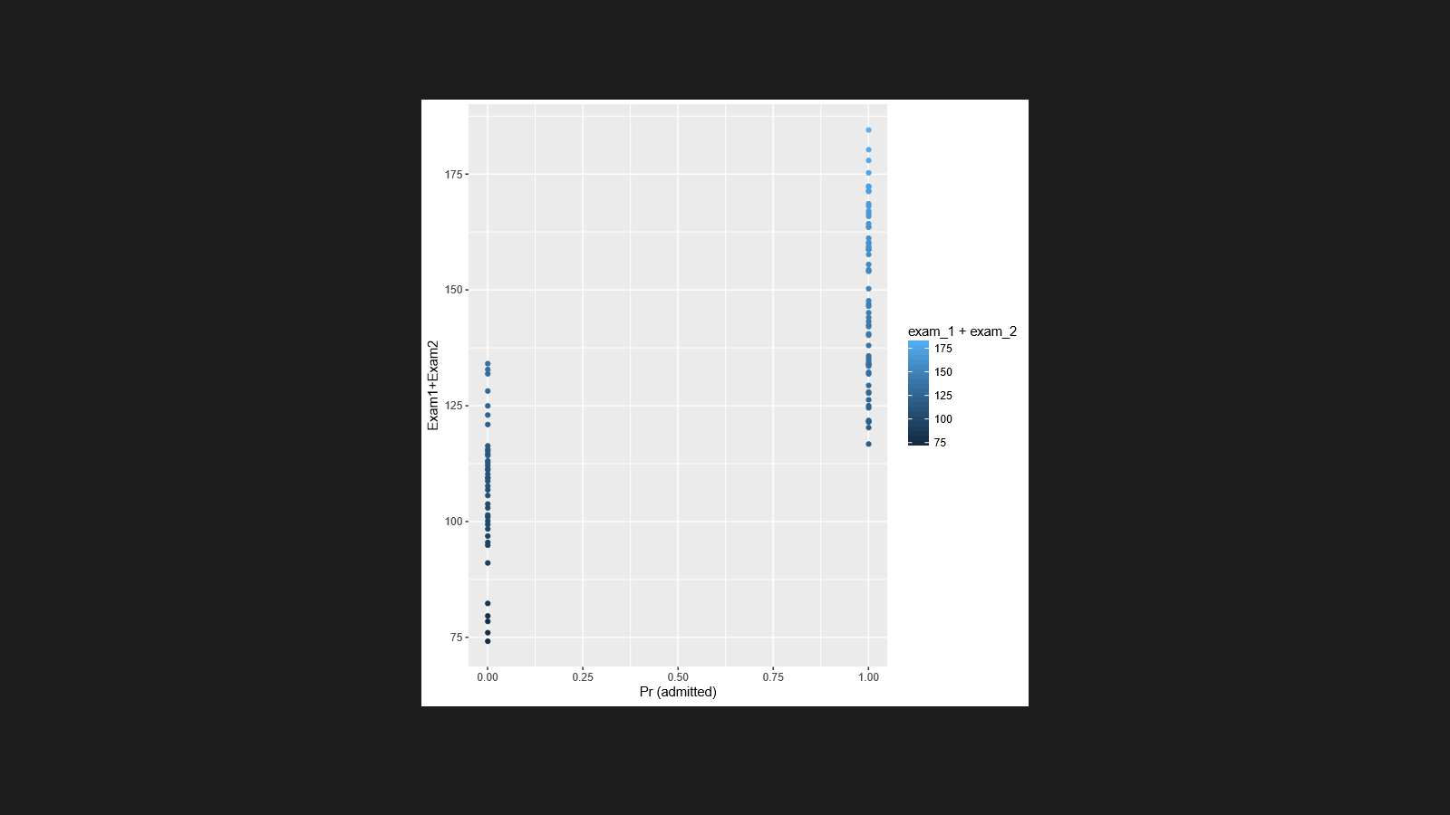
Plot output

Slide 10
'residuals vs fitted', 'normal q-q', 'scale-location', and 'residuals vs leverage' plots

Slide 11


